Slide 1
Lesson 10 Modular Programming
Review of SubVIs
Using SubVIs on the FPGA
Reentrancy and Non-reentrancy in FPGA
Using Name Controls and Constants
Testing FPGA SubVIs
LabVIEW FPGA IPNet

Slide 2
A. Review – Understanding Modularity
Modularity defines the degree to which a program is composed of discrete modules such that a change to one module has minimal impact on other modules
Modules in LabVIEW are called subVIs

Slide 3
Review – SubVIs
A VI within another VI is a subVI
The upper right corner of the front panel and block diagram displays the icon for the VI
This icon identifies the VI when you place the VI on the block diagram

Slide 4

Review - Icon and Connector Pane
After you build a VI, build the icon and the connector pane so you can use the VI as a subVI
The icon and connector pane correspond to the function prototype in text-based programming languages
Every VI displays an icon in the upper-right corner of the front panel and block diagram windows
An icon is a graphical representation of a VI
If you use a VI as a subVI, the icon identifies the subVI on the block diagram of the VI

Slide 5
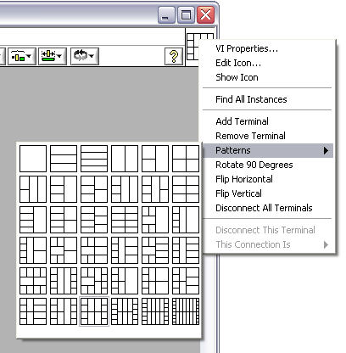
Review - Icon and Connector Pane – Setting up the Connector Pane
Right-click the icon in the upper right corner of the front panel and select Show Connector
Each rectangle on the connector pane represents a terminal
Use the terminals to assign inputs and outputs
Select a different pattern by right-clicking the connector pane and selecting Patterns from the shortcut menu

Slide 6
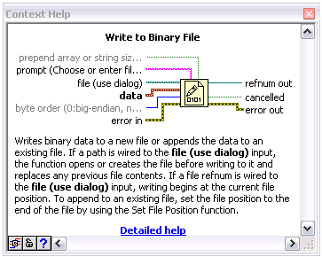
Review - Using SubVIs – Terminal Setting
Bold: Required terminal
Plain: Recommended terminals
Dimmed: Optional terminals

Slide 7
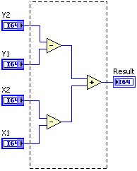
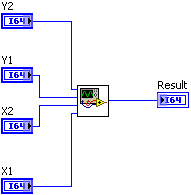
Review - Using SubVIs – Section to SubVI
To convert a section of a VI into a subVI:
Use the Positioning tool to select the section of the block diagram you want to reuse
Select Edit»Create SubVI

Slide 8
B. Using SubVIs on the FPGA
You can run only one top-level FPGA VI
You can use multiple VIs on the FPGA by placing subVIs on the block diagram of the top-level FPGA VI
Placing large controls and indicators on the front panel of a subVI is acceptable
SubVI controls and indicators are not exposed to the host
Notes:
LabVIEW allows you to encapsulate common sections of code as subVIs to facilitate their reuse on the block diagram. While you can run only one top-level FPGA VI, you can use multiple VIs on the FPGA by placing subVIs on the block diagram of the top-level FPGA VI.
Front panel objects in subVIs do not communicate directly with the host VI and therefore do not consume additional space on the FPGA. SubVI controls and indicators that must hold state information from one call to another use registers to store data. SubVI controls and indicators that only pass data into and out of a subVI consume no logic resources on the FPGA.

Slide 9
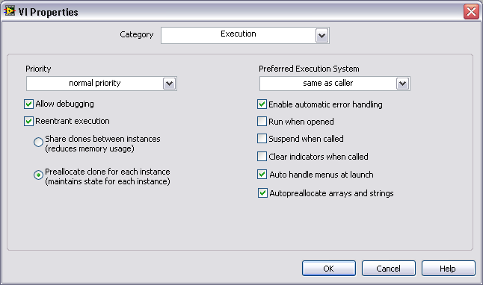
C. Reentrancy and Non-reentrancy in FPGA
Reentrant FPGA SubVI Configuration
Default configuration of VIs created under an FPGA target
Multiple calls to the same subVI run in parallel using separate FPGA resources
Notes:
Instructor note: The two radio buttons underneath the Reentrant execution checkbox are not used by LabVIEW FPGA (even though they still show up in this window).
From LV Help»FPGA Module»Creating FPGA VIs»Using SubVIs on the FPGA

Slide 10
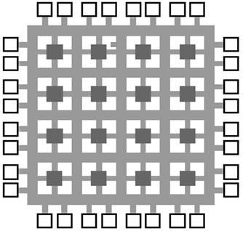
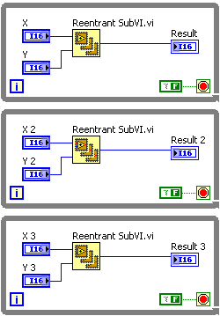

Reentrant FPGA SubVI
Each instance of the reentrant FPGA subVI on the block diagram becomes a separate hardware resource
Notes:
From LV Help»FPGA Module»Creating FPGA VIs»Using SubVIs on the FPGA
Generally improves speed because instances of the subVI execute in parallel
Each instance of the subVI on the block diagram becomes a separate hardware resource. For example, if you have five instances of an event counter configured as a reentrant subVI on the block diagram, LV implements five independent copies of the event counter hardware on the FPGA.

Slide 11
Nonreentrant FPGA SubVI
Single instance shared among multiple callers
Each call to the subVI waits until the previous call ends
Does not allow parallel execution
Notes:
From LV Help»FPGA Module»Creating FPGA VIs»Using SubVIs on the FPGA
Generally saves FPGA space because each instance of the subVI shares the same FPGA hardware… see arbitration caveat.

Slide 12
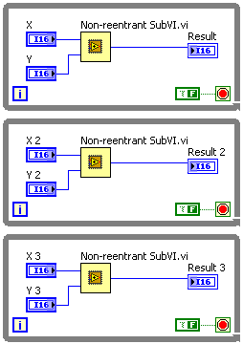

Nonreentrant FPGA SubVI
Only a single copy of the nonreentrant FPGA subVI becomes hardware and all callers share the hardware resource
Notes:
From LV Help»FPGA Module»Creating FPGA VIs»Using SubVIs on the FPGA
Generally saves FPGA space because each instance of the subVI shares the same FPGA hardware… see arbitration caveat.

Slide 13
Reentrancy and Non-reentrancy in FPGA
Tradeoffs
Reentrant is the default VI Type for FPGA VIs
Comparison | Reentrant SubVI | Nonreentrant SubVI
FPGA Resources for VI Logic | Separate for each instantiation | Single set for all instantiations
Parallel Execution | Yes | No
Optimized for… | Speed | Size (Typically)
Use in Single-Cycle Timed Loop | Yes | Only if called from one place

Slide 14

D. Using Name Controls and Constants
Using FPGA Name Controls in SubVIs
FPGA I/O control
FPGA Clock control
Memory control
FIFO control
Notes:
Using Name Controls and Constants (FPGA Module)
The FPGA Module includes the following controls you can use to create VIs with reusable I/O, memory, FIFO, and clocks. These controls are located on the Modern»Name Controls palette. Use the Name Controls to reference FIFOs, memory, clocks, and I/O in subVIs.
FIFO control—Use FIFO controls to specify a FIFO item on the block diagram.
FPGA Clock control—Use FPGA clock controls to pass FPGA I/O clocks to a subVI.
FPGA I/O control—Use FPGA I/O controls to create reentrant subVIs with configurable I/O items.
Memory control—Use memory controls to specify a memory item on the block diagram.
The FPGA Module includes the following constants you can use to create VIs with reusable I/O, memory, FIFO, and clocks.
FIFO constant
FPGA Clock constant
FPGA I/O constant
Memory constant

Slide 15
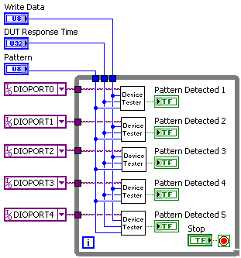
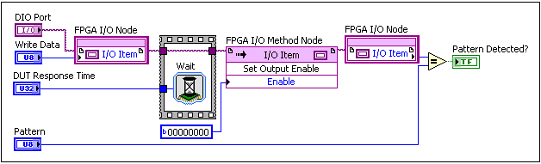
FPGA I/O Control
Passes FPGA I/O items to subVIs
Create VIs that can be used as reentrant subVIs with configurable I/O items
Notes:
Use the FPGA I/O control to pass FPGA I/O items to the block diagram. You can use FPGA I/O controls to create VIs that can be used as reentrant subVIs with configurable I/O items. When you use an FPGA I/O control as an input on a subVI, the input accepts only I/O items that match the specific data type you define for the FPGA I/O control.

Slide 16
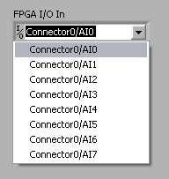

FPGA I/O Control
Place FPGA I/O Node in subVI
Right-click FPGA I/O In input and select Create»Control
Wire the FPGA I/O control to the subVI connector pane

Slide 17
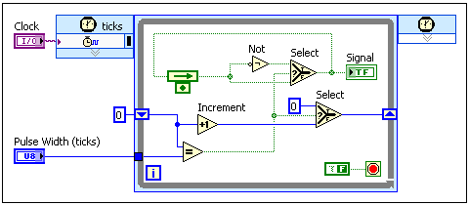
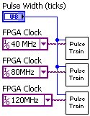
FPGA Clock Control
Pass FPGA Clocks to subVIs
Notes:
Use the FPGA clock control to pass FPGA I/O clocks to the block diagram. For example, the pulse train generator shown in the following block diagram uses an FPGA clock control, Clock, wired to the Source Name input of a Timed Loop.
In the block diagram, the pulse train generator is configured as a reentrant subVI with an FPGA clock input. FPGA clock constants specify the clocks used in each instance of the subVI.

Slide 18
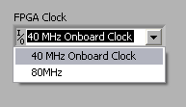
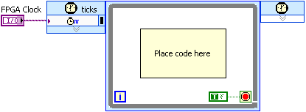
FPGA Clock Control
Place SCTL in subVI
Right-click the Source Name input of an SCTL and select Create»Control.
Wire the clock control to the subVI connector pane

Slide 19


FPGA Memory Control
Pass memory items to subVIs
Right-click the Memory In input of a Memory Method node and select Create»Control
Wire the memory control to the subVI connector pane
Notes:
Memory control—Use memory controls to specify a memory item on the block diagram.

Slide 20
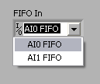
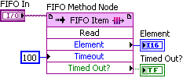
FPGA FIFO Control
Pass FPGA FIFO items to subVIs
Right-click the FIFO In input of a FIFO Method node and select Create»Control
Wire the FIFO control to the subVI connector pane
Notes:
Use FIFO controls to specify a FIFO item on the block diagram.

Slide 21
FPGA Control Restrictions
You cannot change the value of FPGA controls and indicators while an FPGA VI runs on the development computer or when using Interactive Front Panel communication
You cannot access FPGA controls and indicators from the FPGA Interface
You can bundle FPGA controls into clusters with other FPGA controls, but not with other data types
Notes:
You can change the value of an FPGA control on the front panel only when the VI is not running. This is because FPGA control refnums must be constant references during run-time.

Slide 22
E. Testing FGPA SubVIs
Test subVIs as top-level VIs
Execute on development computer
Execute on FPGA target

Slide 23
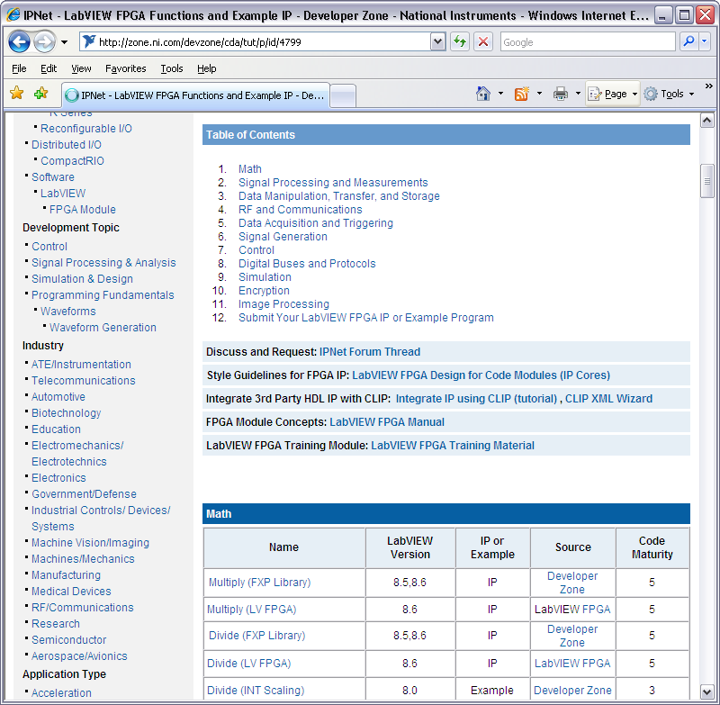
F. LabVIEW FPGA IPNet
LabVIEW FPGA IPNet
Resource for downloading and sharing LabVIEW FPGA functions and intellectual property
Acquire IP needed for your application
Download examples to learn programming techniques
Share your LabVIEW FPGA IP
Notes:
The LabVIEW FPGA IPNet is your one-stop resource for browsing, understanding, and downloading LabVIEW FPGA functions or IP (intellectual property). The table below is a collection of FPGA IP and examples gathered from the LabVIEW FPGA function palette, internal National Instruments developers, and the LabVIEW FPGA community. You should use this resource to acquire IP that you need for your application, download examples to help learn programming techniques, and explore the depth of IP offered by the LabVIEW FPGA platform. In addition to exploring what is offered here, you can also share your LabVIEW FPGA IP or submit an update to existing IP for the LabVIEW community by clicking the link below.
www.ni.com/ipnet

Slide 24
Exercise 10-1: Creating an FPGA SubVI
Create an FPGA subVI and call it from an FPGA main VI.
Notes:
Prep discussion:
In this exercise, the student will create a reentrant FPGA subVI that monitors an AI channel and controls a DIO line. The student will create a FPGA I/O name control in the subVI.
The student will then create a FPGA main VI that monitors three AI channels and controls DIO lines simultaneously by calling three instances of the FPGA subVI in parallel While Loops.

Slide 25
Exercise 10-1: Creating an FPGA SubVI
If you needed to monitor additional AI channels and control additional DIO lines, how would you change your code?
How would the behavior of this application change if you changed the subVI from reentrant to nonreentrant?
Notes:
Make an additional While Loop containing the reentrant subVI for each AI/DIO pair you need to monitor and control.
Each call to the subVI waits until the previous call ends instead of executing in parallel.

Slide 26
Summary—Quiz
True or False? Controls and indicators on an FPGA subVI are exposed to the host VI.

Slide 27
Summary—Quiz Answer
True or False? Controls and indicators on an FPGA subVI are exposed to the host VI.
False.
Notes:
Answer is false.

Slide 28
Summary—Quiz
Which of the following are true for reentrant subVIs in LabVIEW FPGA?
Default configuration of VIs created under an FPGA target
Each instance on the block diagram becomes a separate hardware resource
Optimized for FPGA size
Each call to the subVI waits until the previous call ends
Multiple calls to the same subVI run in parallel

Slide 29
Summary—Quiz Answers
Which of the following are true for reentrant subVIs in LabVIEW FPGA?
Default configuration of VIs created under an FPGA target
Each instance on the block diagram becomes a separate hardware resource
Optimized for FPGA size
Each call to the subVI waits until the previous call ends
Multiple calls to the same subVI run in parallel
Notes:
The answer is a, b, and e.

Slide 30
Summary—Quiz
Which of the following are FPGA name controls that can be passed into FPGA subVIs?
FPGA I/O control
FPGA Clock control
FPGA FIFO control
FPGA Memory control

Slide 31
Summary—Quiz Answers
Which of the following are FPGA name controls that can be passed into FPGA subVIs?
FPGA I/O control
FPGA Clock control
FPGA FIFO control
FPGA Memory control

Slide 32
Continuing Your LabVIEW Education
Instructor Led Training
LabVIEW Real-Time 1
LabVIEW Real-Time 2
LabVIEW Performance
Notes:
Customize this list according to the software and the level of your course.

Slide 33
Continuing Your LabVIEW Education
Training and Certification Membership upgrade
Includes access to all our regional and online classes plus all certifications from 1 yr of purchase
Please contact Customer Education at (866) 337-5918 to receive a quote for Training and Certification Membership
Apply the cost of this course to your membership if you purchase within 30 days

Slide 34
Continue Your Learning
ni.com/support
On Demand training modules: ni.com/src
Access product manuals, KnowledgeBase, example code, tutorials, application notes, and discussion forums
Info-LabVIEW: www.info-labview.org
User Groups: ni.com/usergroups
Alliance Program: ni.com/alliance
Publications: ni.com/reference/books/
Practice!

Slide 35
New User Experienced User Advanced User
LabVIEW Core 1
LabVIEW Core 2
LabVIEW Core 3
Managing Software Engineering in LabVIEW
Advanced Architectures in LabVIEW
LabVIEW Connectivity
Object-Oriented Design and Programming in LabVIEW
LabVIEW Performance
Certifications
Certified LV Associate Developer Exam
Certified LabVIEW Developer Exam
Certified LabVIEW Architect Exam
Other Courses
LabVIEW Real-Time 1
LabVIEW Real-Time 2
LabVIEW FPGA
DAQ & Signal Conditioning
LabVIEW Instrument Control
LabVIEW Modular Instruments
LabVIEW Performance
LabVIEW Machine Vision
Notes:
<Remove this slide if your class is not in the LabVIEW series.>

Slide 36
Thank you!
Please complete the course survey and retrieve your course CD.

